Slide 1


Quality is not Only Our Standard,
It’s Also an Attitude
ECM COMPETENCE CENTER

Slide 2

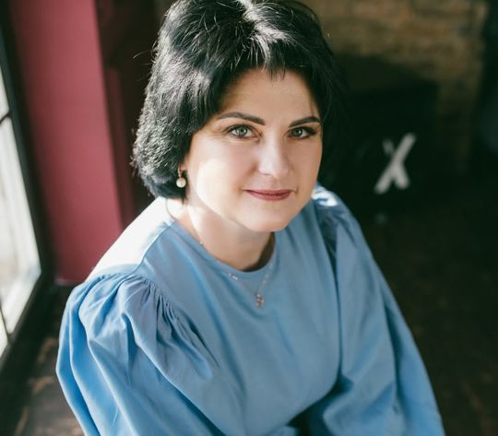
About Us
Mission
The changes we make to the work of our clients are constantly transforming their internal business space. To realize our capabilities, we use the most valuable thing we have: experience and innovative spirit.
Purpose
We strive to become a leading supplier of high-quality software products and services in the field of business analysis and automation of business processes, always be an innovative, creative and to a certain extent aggressive company, while maintaining a financially sound basis.
We strive to ensure that each client is not only satisfied with our work, but also ready to recommend us with confidence in the future.
Helen Olishevska, Head of Board
CENTER ECM is BPM's consulting service and development company that helps visionary companies emphasize their strengths and elevate their brands.

Slide 3

Our competencies
CENTER ECM IS A BPMS SOFTWARE FACTORY
CONFIDENCE. We appreciate the confidence and attend maximum attention and effort for every project
EXPERIENCE. We put our experience in every project, to get an excellent result
STYLE. Every project is unique
ACHIEVEMENTS. We set the pace in the development of modern ЕСМ/ВРМ systems

Slide 4

Why CENTER ECM?
Organizing
Organizing around outcomes not tasks to ensure the proper focus is maintained
Correcting
Correcting and improving processes before (potentially) automating them; otherwise all you’ve done is make the mess run faster
Establishing
Establishing processes and assigning ownership lest the work and improvements simply drift away – and they will, as human nature takes over and the momentum peters out
Standardizing
Standardizing processes across the enterprise so they can be more readily understood and managed, errors reduced, and risks mitigated

Slide 5




















Our clients

Slide 6
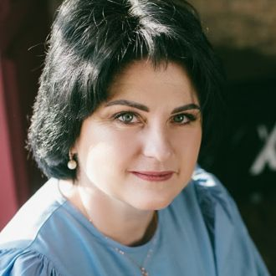
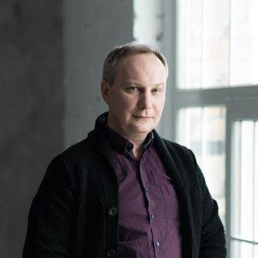
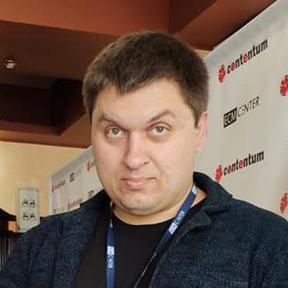


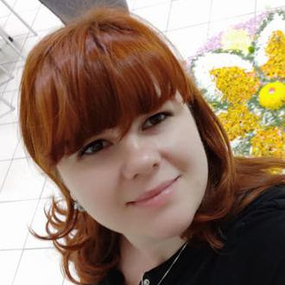
Management
Team
Helen Olishevska
Serg Olishevskyi
Kyryl Mykhailov
Head of Board / CEO
Board Member / CFO
Sales Director
Alex Metelchin
Alina
Tolok
Juliia Pyvovar
EU Sales Manager
Head of PM, pharmaceuticals
Head of PM, finance

Slide 7

Welcome to possible.
Our Services

Slide 8

Business Process Management
MANAGEMENT
Business Process Architecture (BPA)
Business Process Improvement (BPI)
Business Process Reengineering (BPR)
Business Process Optimization (BPO)
AUTOMATION
Robotic Process Automation (RPA)
BPM APPLICATIONS
Business Process Management Solutions (BPMS)
Enterprise Content Management (ECM)
Our customers can leverage the key differentiators of our BPM practice to achieve maximum business benefits in a short amount of time.

Slide 9


CENTER ECM IS A BPMS SOFTWARE FACTORY
Contentum BPM allows you to model, monitor and optimize executable business processes and improve company performance
www.e-contentum.com

Slide 10

Custom Software Development
On the CORPORATE market since 2008
Solving complex and non-typical problems. Design and development of custom software for automation of unique and non-typical business processes that go beyond out-of-the-box solutions.
Flexible approach. We can individually approach each project. We are flexible, building strong and trustful relationships with our partners, actively working and communicating as a single team.

Slide 11

Technologies
Programming languages and platforms
OS’s
Java, .NET, Node.js, JavaScript, TypeScript, Objective-C, C++, C#, PHP, SQL, Python
Windows, macOS, Linux
Our Software Development Technologies
Cloud platforms
Mobile platforms
Microsoft Azure, Amazon Web Services (AWS)
iOS, Android

Slide 12

ECM CENTER IN THE WORLD
ROMANIA
+40 31 229 70 30
office@center-ecm.eu
www.center-ecm.com
POLAND
+48 22 122 02 69
office@center-ecm.pl
www.center-ecm.pl
SWEDEN
+46 81 241 01 37
office@center-ecm.eu
www.center-ecm.eu
UKRAINE
+380 44 594 96 43
office@center-ecm.com.ua
www.center-ecm.com.ua
We look forward to seeing you!
MOLDOVA
+40 31 229 70 30
office@center-ecm.eu
www.center-ecm.com
RUSSIA
+48 22 122 02 68
office@center-ecm.ru
www.center-ecm.ru

Slide 13

Ready to work with us? Here is the best way to get started.
Call Us :
+48 (22) 122 02 68
Visit Us :
Marszałkowska street, 7,
00-626 Warszawa, Poland

