Slide 1



BPM Automation.
Today.
Full business process management lifecycle

Slide 2
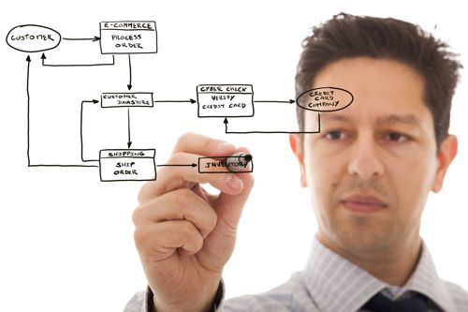
О нас
Full business process management lifecycle
Contentum BPM is Business Process Management Software. It drives digital transformation and allows shifting from job instructions to automated business processes and performance monitoring.
Contentum is based on a BPM engine. It allows you to create flexible and adaptive bpm apps that change quickly with your company. With Contentum it’s easy to streamline your business processes and make their execution more effective

Slide 3

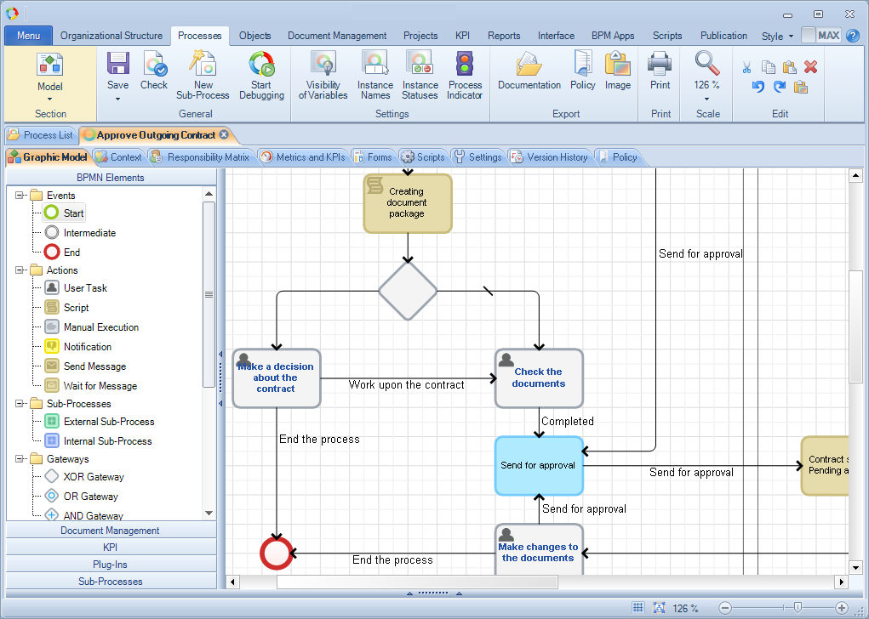
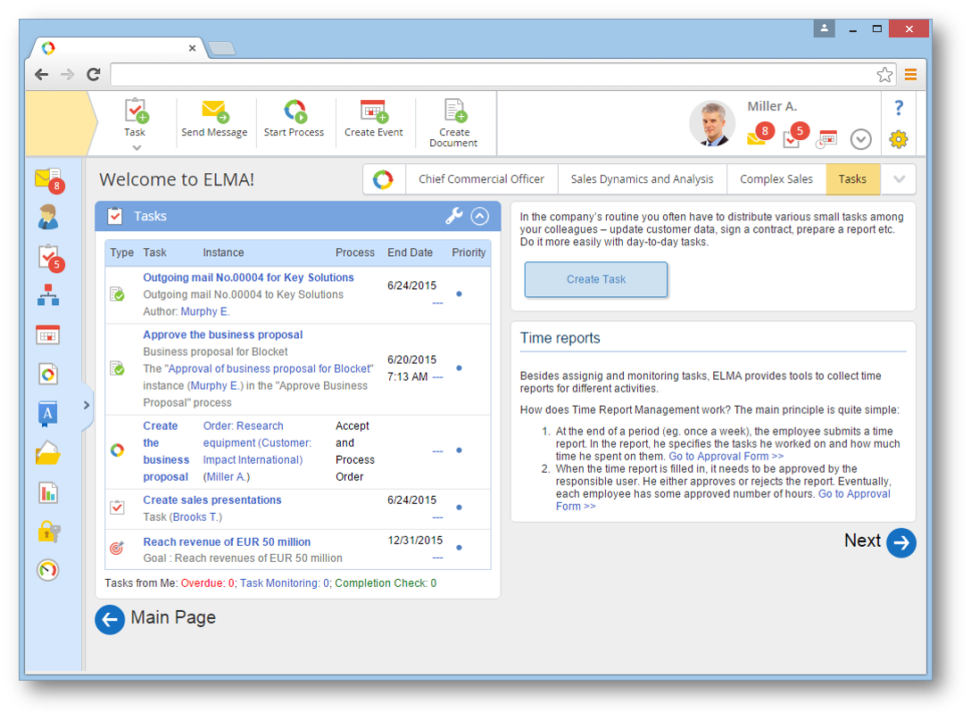
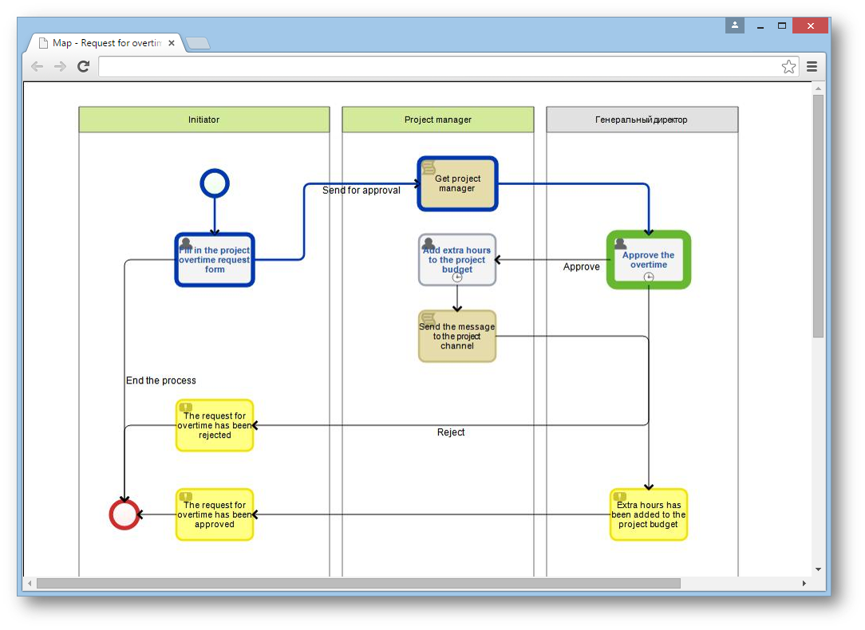
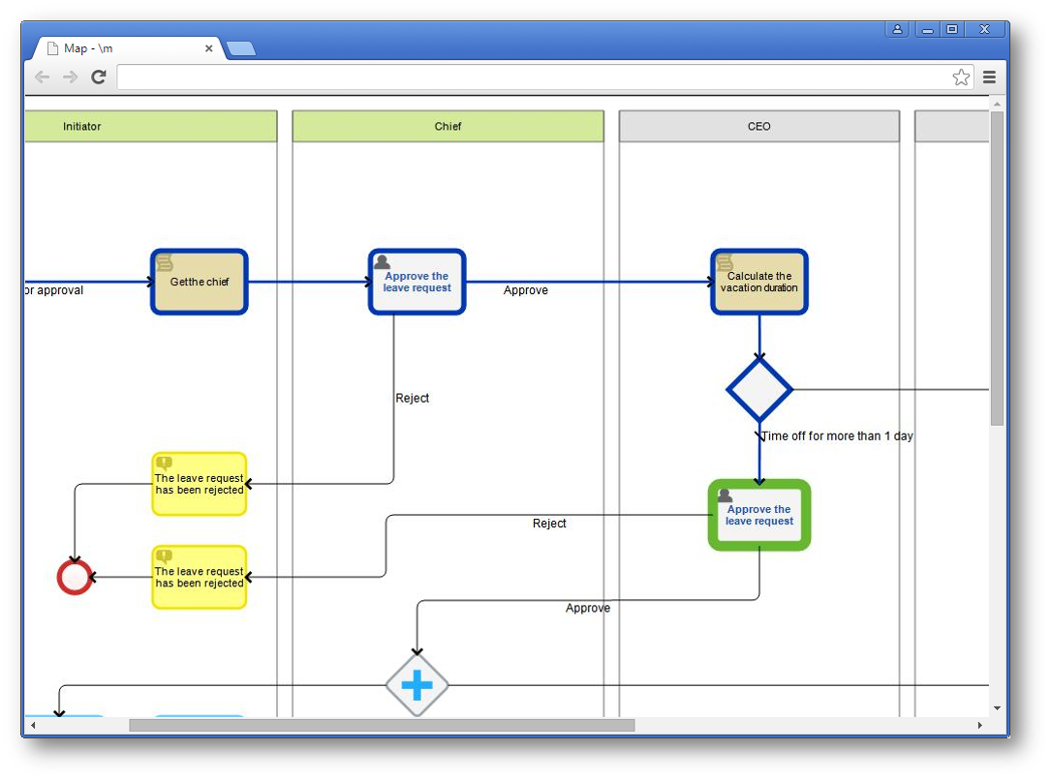
BPM Features
Business
Processes Modeling
Execute Business
Processes
Control and
Monitoring
Processes
Improvement
Work in Contentum BPM begins with business process modeling. Users create business process models in Contentum Designer, a powerful application with a simple and user-friendly interface. Contentum Designer is included in the Contentum BPM software package.
After a business process is modeling and published, you can start executing it in the Contentum BPM web application. You can run as many process instances as you wish. All business process instances are executed independently according to the same process model.
You can control the execution of a business process from its page, e.g. change the parameters, interrupt instances. Contentum BPM offers tools for control and monitoring: My Processes, Process Monitor, Process Maps.
With Contentum BPM you can change processes in the running system with no programming or stopping the server required, and apply changes instantly. You can evaluate how effective the applied changes are, as soon as the process is complete.

Slide 4




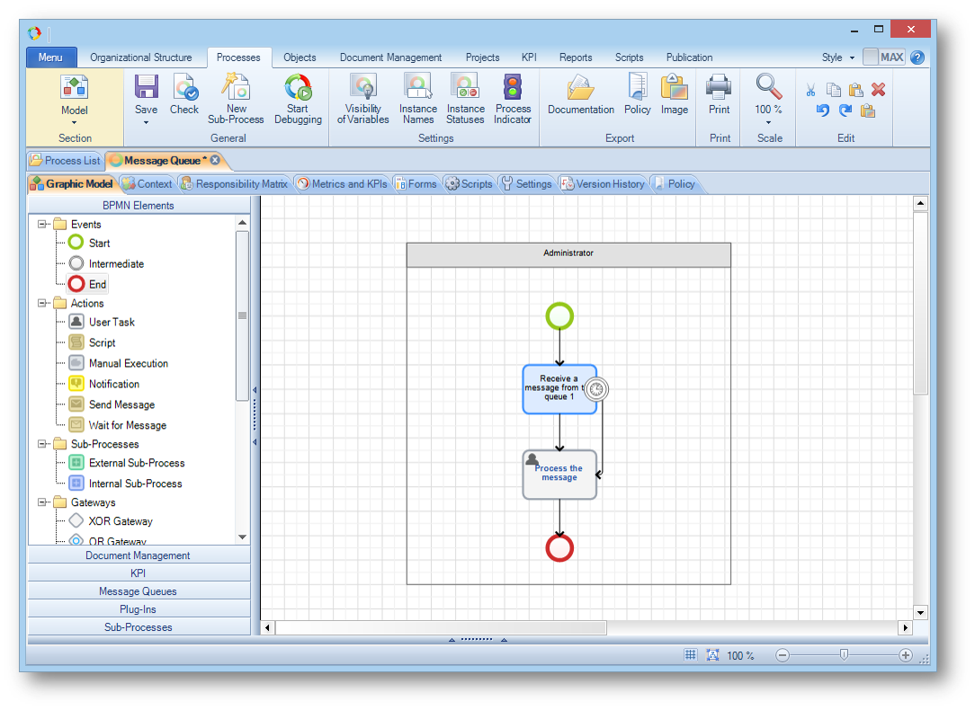
Integration
Contentum integration
Data buses
Contentum support data buses:
Microsoft MQ
Oracle WebLogic
IBM WebSphere
Integration with information systems is one of the key features of the BPM System. The BPM System is a bridge between information systems of a company and the people involved in end-to-end business processes.

Slide 5



Contentum Enterprise
supports Microsoft clustering technologies, allowing you to build scalable systems with workload distribution and high fault tolerance.
Contentum Enterprise
Contentum Enterprise
Contentum Enterprise
SUPPORT
SUPPORT
SUPPORT

Slide 6
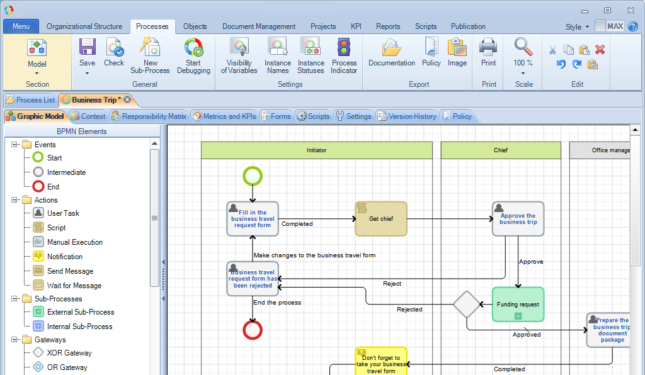
BPMN 2.0
Transparency & BPM
Contentum BPM uses standard notation BPMN 2.0 for business process modeling, that has been extended by our developers during the years of product implementation and testing.
Business processes are modeled in Contentum Designer. It is an easy-to-use tool that allows you to determine process participants by creating swimlanes and represent their actions as a sequence of process steps.
Ключевая фраза или подзаголовок итогового слайда

Slide 7

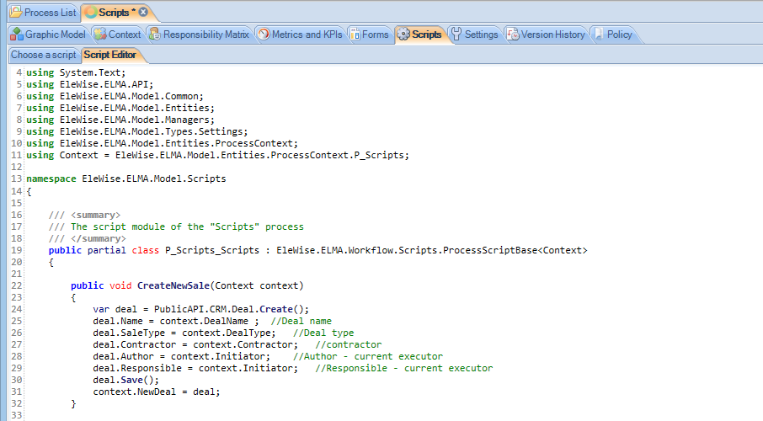
Scripts
For analysts with programming skills, Contentum Designer provides the opportunity to work with the Script activity. Scripts allow executing C# codes at the corresponding stage of a business process.

Slide 8

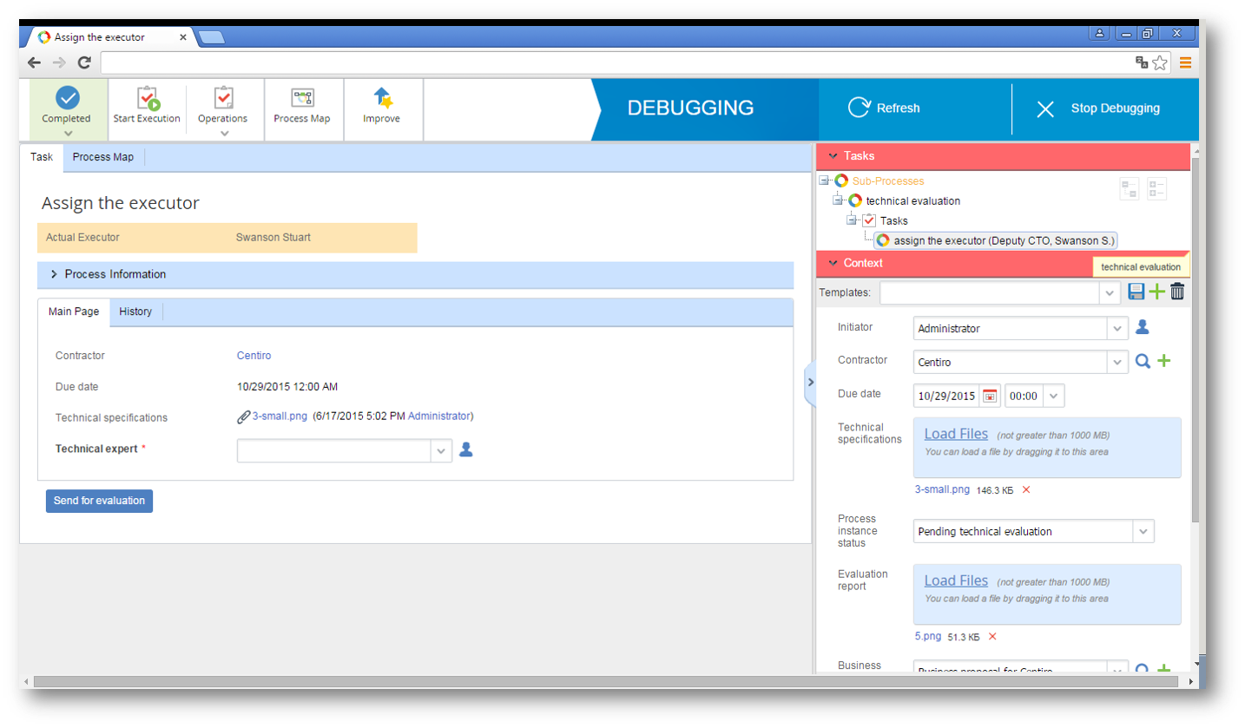
Process Debugging
With Contentum debugging, you can start the process at any step and with any data set. Even during complex processes, debugging allows you to make adjustments instantly.
In the debugging mode, you can visualize the processes current status on the process map, understand who receives which notifications, how conditions and business rules work, what task forms look like and many more.
With debugging you can speed up the whole cycle of business processes implementation. This is an especially useful function when you need to debug a step in the middle of a complicated process.

Slide 9



Mobile Application
Contentum mobile apps provide you with access to task lists, tasks monitoring and messages. The mobile apps support all types of Contentum BPM tasks, including business processes, which allows you to design flexible solutions.
Contentum BPM for Android or iOS transforms your device into a mobile office. The application provides you with a task list, task control and Messages. These Contentum BPM functions are sufficient for quick monitoring of your activities.

Slide 10



Based modules
Simple idea of BPM engine
Contentum KPI
Contentum CRM
Contentum Projects
GOAL MANAGEMENT
PERFOMANCE MANAGEMENT
KPI MANAGMENT
PROCESS KPIS
KPI FOR IPAD
and more...
SALES MANAGEMENT
QUICK SALES
CROSS SALES
BUSINESS PROCESESS
IP-TELEPHONY
and more...
PROJECT SCHEDULE
INTEGRATION WITH MS PROJECT
COMMUNICATIONS PROJECT
BUDGET CONTROL
MANAGE RISKS
and more...

Slide 11











Our Clients
Reach Out

Slide 12
What Clients are Saying About us
“The CENTER ECM are great partners and technically adept at what they do. They are professional, responsive and fun to work with. I always tell people here that ECMC has the best customer service I have ever encountered. Thanks again and I look forward to doing more work with you.”
“CENTER ECM worked with me and the rest of our research team to assess and define a project plan to automate our complex data analysis process which has always been manual. They quickly identified and understood our key needs and suggested creative and cost-efficient solutions to addressing them.”
"
"
"
"
“They provide great quality for the best prices that i have found in the business. I have been very happy with their work to date and recommend them highly. Everyday we hear how extraordinarily easy our platform is to use, integrate, and support. It's played a huge factor in our success. Thanks for the good job!”
Laura Clarke
Financial Services
Mark Cane
Head Of IT
"
"
Jozsef Kuefe
BPM Manager

Slide 13






Welcome to possible.
CENTER ECM
+48 (22) 122 02 68
office@center-ecm.com
http://www.center-ecm.com/

